Slide 1



Data Practices &
Responsible Modeling
Notes:
https://www.figma.com/board/1AVs1SqMRlsZIOPEd22Ins/HCDS-Pedagogy-Tool-FigJam?node-id=191-712&t=6NFo1EypqFU0JT4j-1

Slide 2




Learning Outcomes
Collect, clean, and document data responsibly, including imputation
Discuss data representation (such as underrepresentation)
Interpret models with subgroup analysis
Introduce model-cards and datasheets

Slide 3
What is Machine Learning?
What Are ML Models?
Why We Use ML
With increasingly larger datasets available, data cleaning, preparing and analyzing has become increasingly time consuming and even impossible to do manually.
ML allows data scientists to find patterns and relationships in large data sets more efficiently.
Machine Learning (ML) is the scientific study of Algorithms and Statistical Models used by data scientists to perform specific tasks.

Slide 4
Human-Centered ML
What is “Human-Centered” ML?
Implementation Strategies
Speak to end users about their needs/wants for ML tools
Prioritize transparent sharing of your model and/or results
Understand potential biases at each stage of development and mitigate as they arise
Prioritizing human values, social justice, and stakeholder experiences create fairer, more transparent, responsible ML models.
Collaborative conversations can provide important context regarding training data, model implementation, and validation.

Slide 5
Types of ML Part 1
Goal/Why Supervised?
Output
What is Supervised Learning?
We have labeled inputs
We want to find predictive relationships between input variables and the target variable
Predictions: Model can predict the correct label for new unseen data
Patterns: captures relationships between inputs and outputs
Using labeled training data to identify patterns and predict labels. Its performance is evaluated using labeled test data.
Examples
Linear Regression
Decision Trees
Support Vector Machines

Slide 6
Types of ML Part 2
What is Un- Supervised Learning?
Goal/Why Unsupervised
Output
Have unlabeled data
Cheaper than supervised: labeling is time and money intensive
To discover previously unseen patterns
Looks for previously undetected patterns in datasets with no preexisting labels and minimal human supervision
Discover patterns or structure in the data
Group similar data or reduce complexity
Examples
Cluster Analysis
Principal Component Analysis (PCA)
Anomaly Detection

Slide 7
ML Model Card:
How we communicate to others the use of our model
Model Name and Description:
Intended Use/Out of Scope
Evaluation/Subgroup Considerations
Name of the model used, and a quick description.
What is the primary application
Report what situations or decisions it is not suited for
How the model’s performance was measured
How the model performs across different demographic groups
Identify potential biases or disparities
Training Data:
Data used to train the model.
Failure Modes
Specific examples or scenarios where the model is known to make incorrect or harmful errors.

Slide 8
ML Model Card Example
Student Loan Decision Tree
Makes predictions by splitting data into branches based on feature values until a final prediction is reached. Consists of nodes where each node represents a decision point
Training Data
Evaluation/Subgroup Analysis:
Source: Simple Loan Classification Set, Kaggle
Features: Gender, Education Level, Age, Credit Score
Evaluation Metrics: Accuracy, FNR, FPR, Entropy for specific features
Subgroup Analysis: Accuracy for Gender, Education Level, Age, and Credit Score. Comparison with overall model to determine possible bias.
Intended Use/Out of Scope:
This Model is designed to identify patterns in student loan data to determine common factors for loan denial.
Out of Scope: Should not be used to make lending decisions.
Failure Modes
Model does not account for changing economic, regulatory conditions.
Limited demographic data can lead to bias.
Notes:
Add slide for each DT and k-means: training data, intended use, out-of-scope use, assumptions, limitations, evaluation, subgroup considerations, and failure modes

Slide 9
ML Model Card Example
California Housing K-Means Clustering
Centroid based clustering that groups similar data points into clusters. The algorithm looks for patterns or groupings in the data, organizes points into k number of clusters using the cluster with the nearest mean.
Training Data
Evaluation/Subgroup Analysis:
Source: California Housing Prices Dataset, Kaggle
Features: Longitude, Latitude, Median Income, Median House Value, Population, Households
Evaluation Metrics: Cluster number was decided using the elbow method. Clusters were analyzed using silhouette scores and inertia.
Subgroup Analysis: Evaluation of cluster similarity across Income, House Value, Population, and Household number to allow deeper interpretation of the clusters found.
Intended Use/Out of Scope:
This Model is designed to identify geographic patterns in income in California
Out of Scope: Should not be used for lending decisions.
Failure Modes
Model should not be used for predicting housing prices.
Static snapshot means that subtle changes to geographic neighborhoods overtime may not be captured.
Notes:
Add slide for each DT and k-means: training data, intended use, out-of-scope use, assumptions, limitations, evaluation, subgroup considerations, and failure modes

Slide 10
Subgroup Analysis
Definition
Goal
Should be done by looking at demographics and other subsets of the data to determine bias in a model.
Average performance measures can hide disparities.
Evaluating model performance separately for different subsets or subgroups in the dataset, specifically looking if a model generalizes equally well across different segments of the population or dataset.
Example
Healthcare models can have worse performance for certain ethnic groups [1]
Facial recognition can have worse performance for non-white individuals [2]
Child welfare risk assessments can have better performance for reunified children [3]

Slide 11
Activity 1
Examine the Yellow Taxi Trip dataset and answer the following questions: [NYC Yellow Taxi Trip Data]
Which feature of this dataset could be used as a target variable?
What type of machine learning would you use, which model?
Why are you selecting this type of learning?
What information about the data informs this decision?
What do you expect to learn from the model you used?
What subgroup analysis would be needed during evaluation?
What should be documented before modeling?

Slide 12
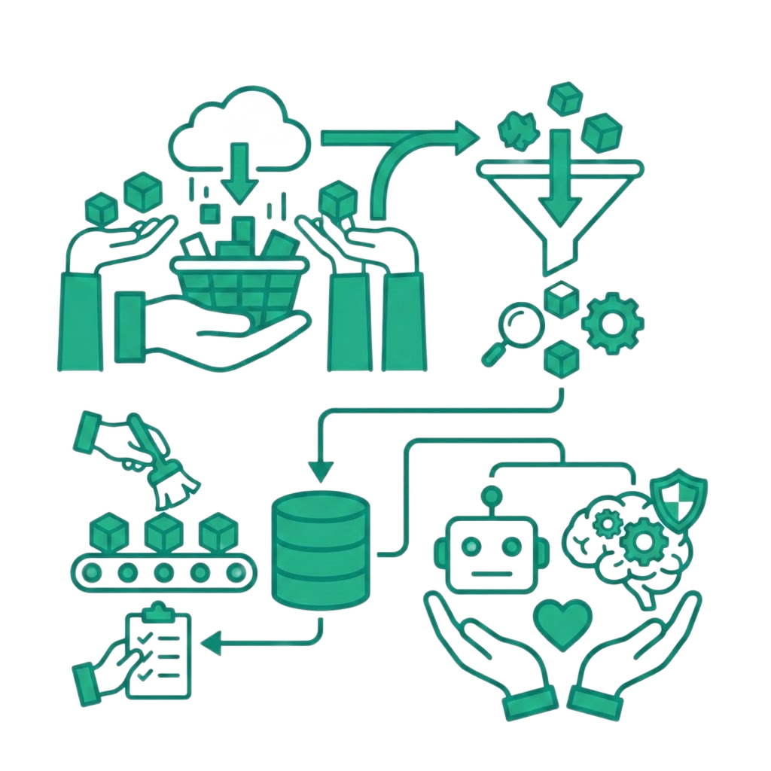
Handling and Visualizing Data
Data Handling
Automated digital tools can streamline data collection, cleaning, and preparation for machine learning, reducing manual effort and speeding up data workflows.
Risks:
Hidden errors and bias
Incorrectly cleaned or mislabeled data
Data storage privacy concerns

Slide 13
Data Representation
Label Quality:
The accuracy of labels attributed to observations
Labels should optimize mirroring “ground truth”
Inaccurate labels can perpetuate bias and/or reduce model generalizability
Proxy Features:
Using other features as “stand-ins” within a dataset
Proxies for demographics and/or protected attributes can lead to discriminate model results
Underrepresentation:
When groups within the population are not proportionally represented in a dataset
Groups can often be defined by: gender, age, sex, disability, ethic background
Using such datasets can result in the perpetuation and/or increase in historical and systemic biases

Slide 14
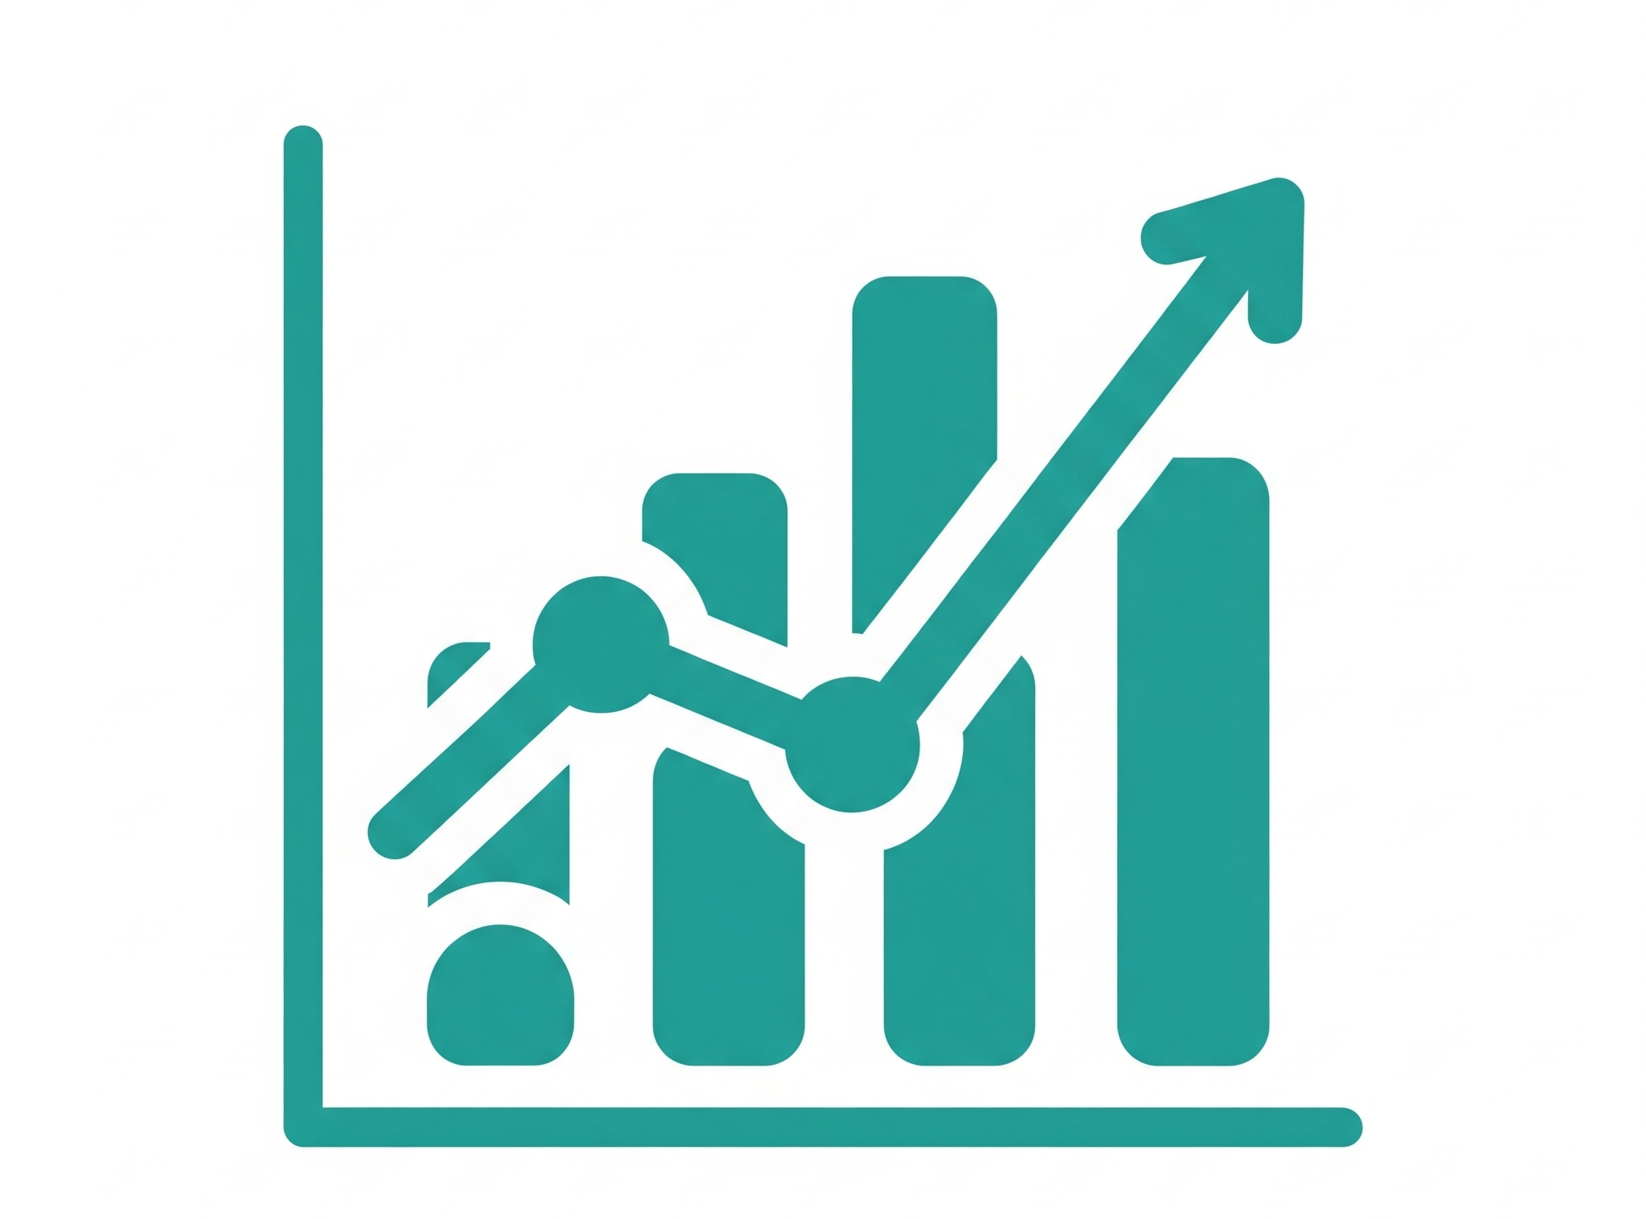
Data Visualization (Exploratory Data Analysis - EDA)
An initial stage in data science problem solving, EDA visually explores the data to:
Understand the composition, range, and complexity of large datasets
Guide development of research questions, make decisions, find patterns, and/or tell a story

Slide 15
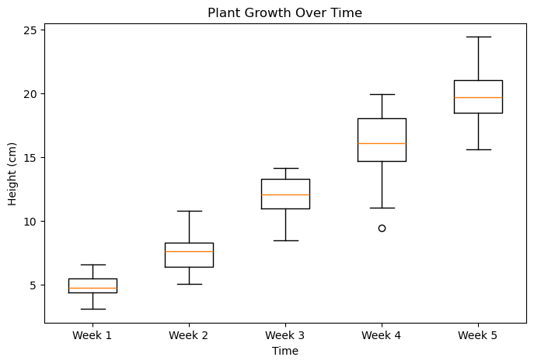
What We Can Learn from EDA
Numeric: range and central tendency of each variable (scatter plot, line charts, histogram, boxplot)
Categorical: distribution and count of each variable, class imbalance (bar plot)
Correlations between variables (heat map)
Anomalies and outliers (boxplot, violin plot)
Missing values
From this information we can generate hypotheses!

Slide 16
1. Principle of Consistency
2. Principle of Importance Ordering
3. Principle of Expressiveness
Visual attributes should match data attributes. Use only one dimension to represent linear data.
The most important information should be encoded in the most impactful format.
Visualizations should utilize colour, shape, and format to express all the information from the dataset.
4. Principle of Effectiveness
A visualization is better than another if the information being conveyed is more easily understood using that visualization.
Types of
Visual Encoding

Slide 17
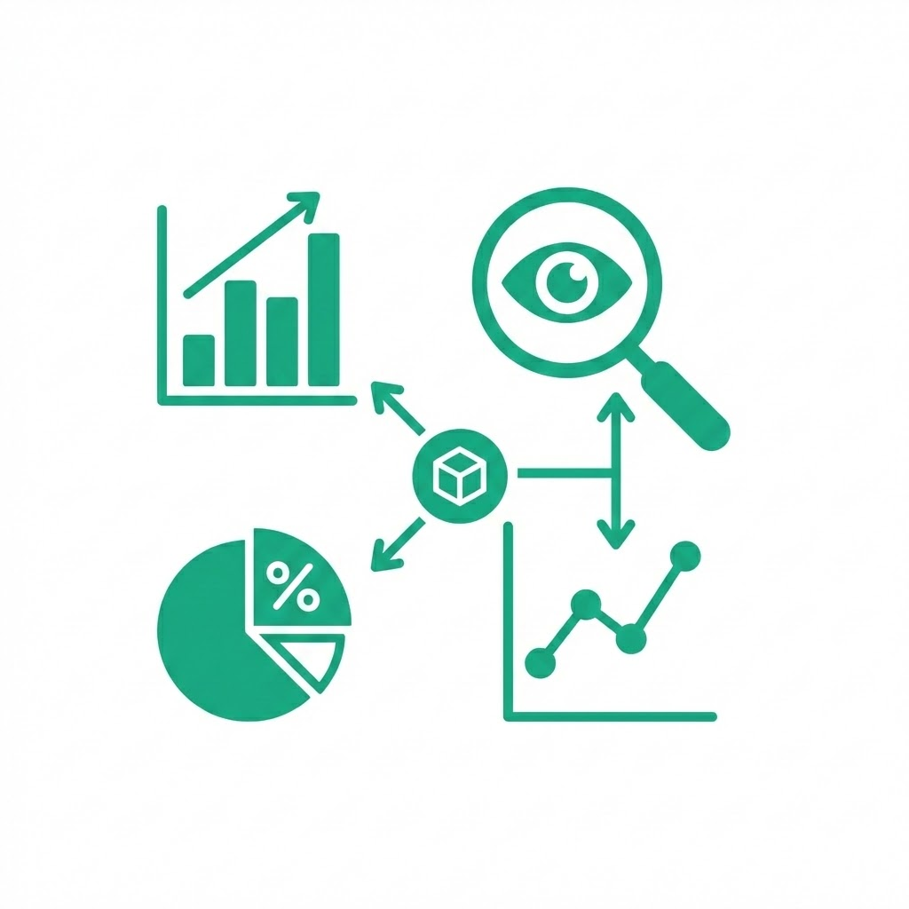
Visualization Tools
Software such as Excel, R (ggplot), Python (matplotlib, Seaborn), PowerBI, and Tableau can be used to visualize data.
Importance of EDA: understand data, develop RQs, present narrative.
Uses of EDA: summarize datasets, visually identify trends, find relationships and patterns.

Slide 18

Activity 2
How would you mitigate bias when collecting, cleaning, and handling data for the model you selected in Activity 1?
Which stakeholders would you talk to in order to help with these concerns? List up to 3

Slide 19
Statistical Applications
Collect, clean, and document data responsibly, including imputation
Discuss data representation (such as underrepresentation)
Interpret models with subgroup analysis
Introduce model-cards and datasheets

Slide 20
Statistics & Removing Bias
Quantitative statistical analysis helps us analyze data and measure patterns.
Bias is systematic errors that distort results or lead to unfair outcomes
Being aware of the potential biases arising from applying statistical methods to data is important to prevent biased or poorly analyzed data. This can ultimately lead to inaccurate models and misleading conclusions.
Addressing bias through the data pipeline ensures that machine learning results are fair and reliable.
Types of biases: societal, statistical, selection, measurement

Slide 21
Bayesian Statistics
Definition
Bayesian Hierarchical Model
In Bayesian Statistics we treat parameters as random variables, and assume that parameters’ values change because the datasets change. As you acquire more data your predictions and probabilities are updated to become more accurate.
Parameters are modeled at multiple levels of a hierarchy, allowing related groups to share information.
Individual observations belong to groups, group parameters are drawn from shared distribution

Slide 22
Parametric Statistics
Definition
ANOVA-Analysis of Variance
Parametric statistical methods assume that data follow a specific probability distribution. These methods look at parameters such as mean and variance, allowing for inferences about the larger population.
Used to compare the means of groups to see if at least one group mean is significantly different from the others.
Comparing exam scores across three teaching methods:
ANOVA tests whether the average scores differ among the three methods.
Highlights potential differences due to an explanatory variable.

Slide 23
Experimental Design
Formal analysis and design of experiments to conduct statistical modeling. Specifically has a set of hypotheses and uses variables to predict an outcome. Refers to experiments in which the design introduces conditions that control variation.
Example:
Clinical trial: Testing the effectiveness of a new drug by assigning patients to treatment and control groups to measure a certain health outcome.
Agricultural study: Varying fertilizer types and amounts on crop plots to predict yield differences.
Education: Implementing educational tools (smart boards, tablets) to assess which are most conducive to increasing student learning outcomes.

Slide 24
Appropriate Training
Example / Cons
Underfitting
A model that is unable to predict future observations reliably
Poor performance
Poor predictive power
Neglect nuanced data patterns.
When machine learning models does not appropriately represent underlying complexity in the data.
Example / Pros & Cons
Overfitting
When a machine learning model fits the training data set perfectly, reducing generalizability to external data.
Only fits current data
Unable to predict unseen or testing datasets reliably
Notes:
Add arrows

Slide 25
Potential Bias Embedding
Bias in Features [1]
Bias in Models
When the input data itself is unrepresentative or skewed, it can lead to inaccurate models and predictions.
When the model’s structure or assumptions favor certain patterns, this limits the types of data it can learn from.
Bias in Outcomes [1,2]
Bias from Other Sources [1,2]
When predictions or decisions systematically favour or disadvantage certain groups.
Includes external factors like societal, historical, or measurement bias that affect the data or the results.

Slide 26
Activity 3: Group Exit Ticket
Research and select an ML model (such as XGBoost, SVM, Random Forest, Logistic Regression or k-NN)
Create a model card.
What is this model used for? What types of data does it require?
Give an example of data this model could be used for.
What feature or target variable would you predict? How would you assess the model’s performance?
What documentation and subgroup evaluation would be required before deployment?

Slide 27
Credits and References
Obermeyer, Z., Powers, B., Vogeli, C., & Mullainathan, S. (2019). Dissecting racial bias in an algorithm used to manage the health of populations. Science (New York, N.Y.), 366(6464), 447–453. https://doi.org/10.1126/science.aax2342
Buolamwini, J. & Gebru, T. (2018). Gender Shades: Intersectional Accuracy Disparities in Commercial Gender Classification. Proceedings of the 1st Conference on Fairness, Accountability and Transparency, in Proceedings of Machine Learning Research 81:77-91 Available from https://proceedings.mlr.press/v81/buolamwini18a.html
Moon, E. S.-Y., Saxena, D., Maharaj, T., & Guha, S. (2024). Beyond Predictive Algorithms in Child Welfare. Proceedings of the 50th Graphics Interface Conference. Presented at Halifax, NS, Canada. https://doi.org/10.1145/3670947.3670976
Mandala, S. K. (n.d.). Simple loan classification dataset [Data set]. Kaggle. https://www.kaggle.com/datasets/sujithmandala/simple-loan-classification-dataset
Nugent, C. (n.d.). California housing prices [Data set]. Kaggle. https://www.kaggle.com/datasets/camnugent/california-housing-prices

